Slide 1
Teachers and Lecturers Job Satisfaction and Wellbeing Survey Presentation of findings
Prepared for:
The Educational Institute of Scotland
Final – April 2014

Slide 2
Content
Background & Objectives, Method
Sample background
Workload, stress, wellbeing
Management and relationships
Professional development and learning
Job satisfaction
Final thoughts
2

Slide 3
Notes for the document
0% = mentioned, but by insufficient numbers to reach 1% of total sample
- = indicates no response at all
Labels for 0%, 1% and 2% have been removed from some charts for ease of reading
‘other’ = refers to responses of insufficient mention to be of specific note (i.e. individual mentions)
Rounding up to one decimal place: where scores are ‘x.x5’ and above
‘nfs’ = a generic responses that has been ‘not further specified’
3

Slide 4
Background & Objectives
The Educational Institute of Scotland (EIS) wished to conduct a survey amongst members to assess their views of their job wellbeing and satisfaction at the present time
Main aim of the research: to find out more about levels of wellbeing and satisfaction with various aspects of the teaching profession
Specific areas of enquiry included:
background details for teachers/lecturers
views on workload, stress and wellbeing
views on management and relationships
views on professional development and learning
overall satisfaction with their job
aspects that give the most and least satisfaction with their job
4

Slide 5
Method
Online survey
hosted by Scott Porter to ensure complete confidentiality and anonymity of survey responses
Initial invitations sent out by EIS to all members (with email details) as part of March e-bulletin on Wednesday 12th March 2014 – link also published in the (hardcopy) Journal → all members invited to take part
Reminder email then sent out to all members on Friday 21st March 2014
Survey closed at end of play on Friday 28th March 2014
Total of 6,897 fully completed surveys submitted by this time
accounting for 12.8% of the total (paying) membership of 53,800
a total sample of 6,897 gives a margin of error (at standard MRS confidence interval of 95%) of between 0.33% and 1.18%
5

Slide 6
Sample background

Slide 7
Sector
Broadly reflects the membership profile
Q2: Sector
Base: All respondents (n=6,897)
7

Slide 8
Gender & Age
Nursery 97%
Primary 92%
Special 85%
More females overall, especially in Nursery, Primary and Special education
More males in Secondary, Further and Higher
Mix of ages across the board – slight tendency towards older age groups
Higher 54%
Further 47%
Secondary 38%
Q7 & Q8: Gender, Age
Base: All respondents (n= 6,897)
8

Slide 9
Length of time a teacher/lecturer
A mix of experience across the sample
But, all in all more respondents have long term experience of the profession
– 52% with 15 years or more
Especially true at 20+ years for:
Nursery = 59% / Higher = 48% / Special = 45%
Q1: Length of time a teacher
Base: All respondents (n=6,897)
9

Slide 10
Position - all levels represented -
Special, Nursery and Primary education
Secondary education
Q3: Position
Base: Special, Nursery, Primary (n=3,700) / Secondary (n=2,499)
10

Slide 11
Position - all levels represented -
Further education
Higher education
Q4: Position
Base: Further (n=557) / Higher (n=141)
11

Slide 12
A mix of subjects taught for secondary, higher and further education
 | % |  | %
English | 13% | Geography | 4%
Mathematics | 10% | Physics with Science | 4%
Technological Education | 10% | Music | 4%
Business Education | 8% | Religious Education | 4%
Art & Design | 7% | ASN / Support | 4%
Computing / ICT | 7% | Home Economics | 4%
Modern Foreign Languages | 6% | PSE / Guidance | 3%
Physical Education | 6% | Media Studies | 2%
Biology with Science | 5% | Drama | 2%
Chemistry with Science | 5% | Psychology | 2%
Modern Studies | 5% | TESOL / ESOL / EAL | 2%
History | 5% | Sociology | 2%
 |  | Engineering (etc.) | 2%
1%: Economics Philosophy Health/nursing Hospitality/travel & tourism Construction/building trades Social work/care Hairdressing/beauty therapy Early years education 0%: Classics / Latin / Greek Community Languages / Gaelic Geology Photography Sport/fitness Agriculture/horticulture/animal care Communication Environmental science/ecology Employability/work preparation Media production Politics Law Non-teaching role 3%: ‘other’
Q6: Subject
Base: Secondary, Higher and Further (n=3,197)
12

Slide 13
Workload, stress, wellbeing

Slide 14
Mixed views on work life balance at the present time, with a range of 4.0 to 5.4 for average scores
Very bad work life balance
Very good work life balance
Mean score
4.3
4.3
4.8
4.0
4.4
4.9
5.4
Q8: How would you rate your work life balance at the present time?
Base: All respondents (n=6,897)
14

Slide 15
More worrying – Secondary, Higher and Primary all have 60% or more giving ‘bad’ work life balance scores (1-4)
Very bad work life balance
Very good work life balance
Mean score
4.3
4.0
4.3
4.4
4.8
4.9
5.4
Q8: How would you rate your work life balance at the present time?
Base: All respondents (n=6,897)
15

Slide 16
Satisfaction with workload levels at the present time (i.e. this week) not high – a mere 3 out of 10
A third+ of Secondary score just 1 out of 10 = very dissatisfied
Not at all satisfied
Completely satisfied
Mean score
3.3
3.7
3.8
2.7
3.5
4.1
4.4
Q10: How satisfied are you with your workload levels at the present time – i.e. this week?
Base: All respondents (n=6,897)
16

Slide 17
Indeed 3 in 4 or more Secondary and also Primary give dissatisfaction scores of 1 to 4 for current workload
Not at all satisfied
Completely satisfied
Mean score
3.3
2.7
3.5
3.7
3.8
4.1
4.4
Q10: How satisfied are you with your workload levels at the present time – i.e. this week?
Base: All respondents (n=6,897)
17

Slide 18
Scores for satisfaction with workload levels generally reflect those for this week – a dissatisfied 3 out of 10
Not at all satisfied
Completely satisfied
Mean score
3.2
3.4
3.7
2.8
3.4
3.9
4.1
Q11: And how satisfied are you with your workload levels generally – say over the last 6 months or so?
Base: All respondents (n=6,897)
18

Slide 19
Joining Secondary, again Primary and Higher also give low scores for satisfaction with workload levels generally
Not at all satisfied
Completely satisfied
Mean score
3.2
2.8
3.4
3.4
3.7
3.9
4.1
Q11: And how satisfied are you with your workload levels generally – say over the last 6 months or so?
Base: All respondents (n=6,897)
19

Slide 20
High rates of feeling stressed across the board, not only ‘occasionally’, but also ‘all the time’
Q12: How often do you feel stressed within your job?
Base: All respondents (n=6,897)
20

Slide 21
Whilst respondents score across the scale there are high levels of stress at the present time, especially Secondary
I am not stressed at all
I feel extremely stressed
Mean score
3.8
4.0
4.1
3.2
4.0
4.4
4.5
Q13: What level of stress would you say you feel within your job overall at the moment?
Base: All respondents (n=6,897)
21

Slide 22
Worryingly, 50% or more of each sector score 1 to 4, saying very or extremely stressed at the moment
I am not stressed at all
I feel extremely stressed
Mean score
3.8
3.2
4.0
4.0
4.1
4.4
4.5
Q13: What level of stress would you say you feel within your job overall at the moment?
Base: All respondents (n=6,897)
22

Slide 23
Comparisons of levels to same point last year show there is more stress now – especially Secondary
Q14: Think back to this time last year – how would you say your stress levels within your job are now compared to then?
Base: All respondents (n=6,897)
23

Slide 24
3 aspects of work top the list for giving respondents the most stress in the past 12 months
Primary 50%
Secondary 49%
Higher 23%
Excessive workload, changes to the curriculum and dealing with management have caused most stress
Q15: Which one aspect of your work has provided you with the most stress in the past 12 months?
Base: All respondents (n=6,897)
(See Appendix for list of ‘other’ responses)
24

Slide 25
Level of wellbeing in job overall – a broad range of scores -
I do not feel well within my job
I feel very well within my job
Mean score
4.7
4.7
4.6
4.4
4.9
5.4
5.3
Q16: What level of wellbeing would you say you feel within your job overall (i.e. how comfortable, healthy and happy do you feel within your job)?
Base: All respondents (n=6,897)
25

Slide 26
Focussing in, majority do not feel well within their job overall – especially Secondary, Higher, Further
I do not feel well within my job
I feel very well within my job
Mean score
4.7
4.4
4.7
4.6
4.9
5.3
5.4
Q16: What level of wellbeing would you say you feel within your job overall (i.e. how comfortable, healthy and happy do you feel within your job)?
Base: All respondents (n=6,897)
26

Slide 27
Workload clearly has the most impact in making up wellbeing at work – across all sectors
Secondary 57%
Higher 43%
Further 29%
Higher 28%
Q17: What are the 3 most important elements of your job in teaching that go towards making up your wellbeing at work?
Base: All respondents (n=6,897)
(See Appendix for list of ‘other’ responses)
27

Slide 28
Management and relationships

Slide 29
Collegiate practice used most in Primary, Special and Nursery – 50% or more at least ‘quite a lot’
Quite or All
45%
62%
50%
59%
32%
14%
9%
Is this not used in Further and Higher education?
Q18: To what extent does your school/college/university make use of collegiate practice?
Base: All respondents (n=6,897)
29

Slide 30
40% overall operate a distributive leadership model – more so in Nursery, Primary and Special
Interestingly there appears to be a correlation between a ‘yes’ here and scoring higher for wellbeing, satisfaction with workload and satisfaction generally, as well as being less stressed
 | Spec -ial | Nurs -ery | Prim -ary | Secon -dary | Fur -ther | High -er
Yes | 41% | 55% | 49% | 33% | 14% | 15%
No | 30% | 21% | 26% | 33% | 48% | 54%
D/K | 29% | 24% | 25% | 34% | 38% | 31%
Q19: Would you say your school/college/university operates a distributive leadership model?
Base: All respondents (n=6,897)
30

Slide 31
4 in 5 agree that their relationships are positive – slightly more so with students than colleagues
% agree
84%
79%
 | Special | Nursery | Primary | Secondary | Further | Higher
% agree - students | 85% | 84% | 86% | 84% | 77% | 77%
% agree - colleagues | 79% | 78% | 82% | 79% | 67% | 71%
Q20: Think of the staff and the children/students you teach – how much do you agree with each of the following statements?
Base: All respondents (n=6,897)
31

Slide 32
Professional development and learning

Slide 33
More disagree than agree on professional development/ learning – most with having time to dedicate to this
32% disagree v. 42% agree
42% disagree v. 39% agree
70% disagree v. 21% agree
44% disagree v. 27% agree
Q21: Think now of professional development and learning – how much do you agree with each of the following statements?
Base: All respondents (n=6,897)
33

Slide 34
More disagreement than agreement overall
Most disagreement: - Secondary for having sufficient time - Secondary, Further and Higher for future opportunities
 | Total | Special | Nursery | Primary | Secondary | Further | Higher
My PRD objectives for the year are clear and actionable | 42% agree | 46% agree | 50% agree | 35% agree | 40% agree | 30% agree | 35% agree
I receive sufficient professional development and learning opportunities to do my job well | 39% agree 42% disagree | 43% agree | 50% agree | 42% agree | 34% agree | 34% agree | 40% agree
I have sufficient time to dedicate to professional development and learning | 70% disagree | 60% disagree | 65% disagree | 69% disagree | 75% disagree | 64% disagree | 68% disagree
Looking to the future I feel I will have sufficient opportunity to further my career should I so wish | 44% disagree | 40% disagree | 36% disagree | 38% disagree | 51% disagree | 54% disagree | 56% disagree
Q21: Think now of professional development and learning – how much do you agree with each of the following statements?
Base: All respondents (n=6,897)
34

Slide 35
Job satisfaction

Slide 36
Again a full range of responses for overall job satisfaction – with a mid-score of 5 out of 10
Not at all satisfied
Completely satisfied
Mean score
5.0
4.9
4.8
4.6
5.2
5.7
5.6
Q22: How satisfied are you with your job overall?
Base: All respondents (n=6,897)
36

Slide 37
Mixed views, but job dissatisfaction is high and even for the most satisfied Nursery group only 44% score 7 to 10
Not at all satisfied
Completely satisfied
Mean score
5.0
4.6
4.9
4.8
5.2
5.6
5.7
Q22: How satisfied are you with your job overall?
Base: All respondents (n=6,897)
37

Slide 38
Likelihood to be in teaching a year from now is very high, around half giving this a definite 10 out of 10
Definitely will not be in teaching
Definitely will be in teaching
Mean score
8.5
8.7
8.4
8.4
8.8
8.2
7.5
Q23: How likely do you think it is that you will still be teaching in ….a year from now?
Base: All respondents (n=6,897)
38

Slide 39
Not surprisingly, a less definitive response for 5 years time – and more say ‘no’ 1-4 (up 15% to 24% overall)
Definitely will not be in teaching
Definitely will be in teaching
Mean score
6.4
6.8
6.2
6.3
6.2
5.7
5.1
Q23: How likely do you think it is that you will still be teaching in ….5 years from now?
Base: All respondents (n=6,897)
39

Slide 40
Very mixed responses to likelihood of telling someone teaching is a worthwhile job to do
Definitely would not say teaching is worthwhile
Definitely would say teaching is worthwhile
Mean score
5.6
6.1
5.8
5.5
5.6
6.3
5.7
Q24: How likely would you be to tell someone thinking of entering the profession that teaching is a worthwhile job to do?
Base: All respondents (n=6,897)
40

Slide 41
Indeed for most sectors about as many would say it is a worthwhile job as would say it’s not – except Nursery
Definitely would not say teaching is worthwhile
Definitely would say teaching is worthwhile
Mean score
5.6
6.3
6.1
5.8
5.6
5.7
5.5
Q24: How likely would you be to tell someone thinking of entering the profession that teaching is a worthwhile job to do?
Base: All respondents (n=6,897)
41

Slide 42
Also mixed views for likelihood of recommending teaching as a good profession to take up
Definitely would not recommend
Definitely would recommend
Mean score
5.0
5.7
5.2
4.9
5.0
5.4
5.2
Q25: How likely would you be to recommend teaching as a good profession to take up to someone thinking of entering the profession?
Base: All respondents (n=6,897)
42

Slide 43
Although overall slightly fewer would recommend teaching than say it’s a worthwhile job
Definitely would not recommend
Definitely would recommend
Mean score
5.0
5.7
5.2
4.9
5.0
5.4
5.2
Q25: How likely would you be to recommend teaching as a good profession to take up to someone thinking of entering the profession?
Base: All respondents (n=6,897)
43

Slide 44
Top 3 aspects of the job that give most satisfaction = students, colleagues, time off!
Q26: When you think of teaching what are the top 3 aspects of the job that give you the most satisfaction?
Base: All respondents (n=6,897)
(See Appendix for list of ‘other’ responses)
44

Slide 45
No real difference between sectors looking at top 5 most frequently mentioned for most satisfaction
 | Total | Special | Nursery | Primary | Secondary | Further | Higher
My achievements with students | 82% | 83% | 82% | 83% | 80% | 83% | 82%
The students | 81% | 82% | 84% | 84% | 80% | 77% | 76%
My colleagues | 42% | 40% | 45% | 49% | 34% | 38% | 37%
Holidays | 41% | 43% | 47% | 43% | 36% | 48% | 26%
Exam success | 12% |  |  |  | 28% | 15%
New things to train for | 8% | 14% | 10% | 9% |  |  | 16%
Other ‘top’ mentions – receiving 10% or more:
My working hours: Special 10% & Higher 11%
Extra curricular work: Secondary 18% & Higher 13%
New things to train for: Further 10%
Exam success: Higher 10%
Q26: When you think of teaching what are the top 3 aspects of the job that give you the most satisfaction?
Base: All respondents (n=6,897)
45

Slide 46
4 aspects give least satisfaction = workload, curriculum changes, hours, management team
Q27: What are the 3 aspects of the job that give you the least satisfaction?
Base: All respondents (n=6,897)
(See Appendix for list of ‘other’ responses)
46

Slide 47
Top 5 most frequently mentioned for least satisfaction show some differences by sector
Sector differences – least satisfied with:
Changes to curriculum: Secondary (75% v 60% total)
My working hours: Primary (52% v 42% total)
My management team: Further and Higher (both 65% v 35% total)
New things to train for: Nursery (27% v 16% total)
Extra curricular work: Further (26% v 11% total)
 | Total | Special | Nursery | Primary | Secondary | Further | Higher
My workload | 83% | 74% | 83% | 86% | 83% | 70% | 72%
Changes to curriculum | 60% | 59% | 51% | 53% | 75% | 41% | 20%
My working hours | 42% | 33% | 35% | 52% | 35% |  | 31%
My management team | 35% | 35% | 27% | 27% | 36% | 65% | 65%
Remuneration | 23% | 26% |  | 20% | 25% | 24% | 29%
New things to train for | 16% |  | 27%
Extra-curricular work | 11% |  |  |  |  | 26%
Q27: What are the 3 aspects of the job that give you the least satisfaction?
Base: All respondents (n=6,897)
47

Slide 48
1 thing to change to make life as a teacher better? No – a multitude!! (1)
 |  | Total | Special | Nursery | Primary | Second-ary | Further | Higher
Paperwork | Less paperwork/ bureaucracy | 18% | 19% | 28% | 27% | 9% | 8% | 11%
Workload | Lessen workload | 9% | 6% | 6% | 10% | 8% | 7% | 6%
 | Better work life balance/ not taking work home | 3% | 2% | 6% | 4% | 2% | 1% | 4%
 | More time to teach/ do my job | 3% | 2% | 5% | 3% | 5% | 4% | 4%
 | More time for preparation, planning, marking etc. | 5% | 3% | 5% | 3% | 7% | 11% | 4%
Curriculum | Less changes to curriculum, new initiatives etc,/ give time to embed | 8% | 8% | 4% | 9% | 8% | 4% | -
 | More support for new curriculum | 5% | 2% | 2% | 3% | 11% | 1% | -
 | Scrap CfE, sort the mess | 3% | 1% | - | 2% | 7% | - | -
 | More time to implement new curriculum/ delay new Highers | 2% | - | - | 0% | 5% | 1% | -
 | No internal assessment (for Nat 4) | 3% | - | 1% | 1% | 6% | 1% | -
Q28: What 1 thing would you change to make your life as a teacher better? (open response)
Base: All respondents (n=6,897)
48

Slide 49
1 thing to change to make life as a teacher better? No – a multitude!! (2)
 |  | Total | Special | Nursery | Primary | Second-ary | Further | Higher
Resources | More resources/funding | 3% | 2% | 3% | 3% | 3% | 3% | 4%
 | More staff/supply cover | 3% | 3% | 3% | 3% | 2% | 3% | 9%
 | More classroom assistants / support for inclusion / ASN pupils | 4% | 5% | 3% | 7% | 1% | 0% | 1%
Manage-ment | Autonomy/ trust professionalism / leave me to do my job | 4% | 4% | 4% | 5% | 3% | 2% | 2%
 | Better management/ leadership | 5% | 7% | 4% | 5% | 5% | 11% | 9%
 | More communication/ consultation about changes etc. | 3% | 3% | 2% | 2% | 3% | 5% | 2%
 | Improve discipline/ behaviour/ more robust policies from management | 4% | 3% | - | 4% | 5% | 1% | 1%
Salary | Pay increase / parity | 4% | 6% | 2% | 3% | 4% | 5% | 6%
Q28: What 1 thing would you change to make your life as a teacher better? (open response)
Base: All respondents (n=6,897)
(See Appendix for list of ‘other’ responses)
49

Slide 50
‘Wordle’ shows consistent and frequent words running through final comments on what should be addressed to help teachers have a sense of wellbeing in their profession in 2014:
Q29: Is there anything else that you would like us to consider in terms of helping teachers ensure they have a sense of wellbeing within their profession for 2014? (open response)
Base: All respondents who responded (n=4,180)
(See separate Verbatim Book for list of all responses for Q29.)
50

Slide 51
Summary, conclusions and final thoughts

Slide 52
A summary of positive scores shows how little wellbeing and satisfaction there is overall
Satisfied with job → 33% *
Feel very well – high wellbeing in job → 26%
Very good work life balance → 22%
Not at all stressed at the moment → 16%
Never/very rarely feel stressed → 0% never / 5% very rarely
A lot/a little less stress v. last year → 14%
Satisfied with workload at present → 12%
Satisfied with workload in general → 9%
Definitely say teaching worthwhile job → 42%
Definitely recommend teaching → 33%
* Scores of 7 to 10
52

Slide 53
Looking across sectors Secondary education clearly shows the lowest levels of satisfaction
 | Total | Nursery | Special | Higher | Further | Primary | Secondary
Satisfied with job | 33% | 44% | 43% | 29% | 29% | 35% | 27%
Feel very well – high wellbeing in job | 26% | 36% | 35% | 25% | 24% | 29% | 22%
Very good work life balance | 22% | 29% | 40% | 22% | 27% | 22% | 20%
Not at all stressed at moment | 16% | 22% | 25% | 16% | 18% | 17% | 10%
Never/very rarely feel stressed | 0% never 5% rarely | 0% 9% | 1% 7% | 1% 6% | 1% 8% | 0% 5% | 0% 5%
A lot/little less stress v. last year | 14% | 20% | 22% | 14% | 15% | 17% | 9%
Satisfied with workload at present | 12% | 21% | 26% | 14% | 17% | 11% | 8%
Satisfied with workload in general | 9% | 16% | 21% | 10% | 15% | 9% | 7%
Definitely say teaching worthwhile job | 42% | 55% | 42% | 46% | 44% | 42% | 40%
Definitely recommend teaching | 33% | 37% | 37% | 37% | 34% | 33% | 32%
53

Slide 54
Overall conclusions
Wellbeing and satisfaction with the teaching profession at the present time are low and stress levels are very high
Views can be very mixed – perhaps highlighting inconsistency with the teaching experience across different teaching institutions
Whilst Secondary and perhaps Primary are least satisfied, the main plus points and issues for the profession are consistent across all sectors
Positives relate principally to students and teachers’ achievements with them, followed by valuing colleagues – and then holidays (a little worrying that the 4th most satisfying aspect of the job is the time they don’t spend doing it?)
The main issues to resolve are clear, consistent across many responses and interlinked:
excessive workload and working hours being ‘demanded’
linked to this – the very large amount of (unnecessary) paperwork
number and speed of changes – in particular to the curriculum (CfE)
issues with management/leadership
54

Slide 55
Final thoughts
All in all it appears that teachers and lecturers feel they are climbing a never ending mountain that makes more and more demands of them, with little prospect of respite!
Responses therefore show that teachers and lecturers, as well as being dissatisfied, do not feel that they are being heard, valued as professionals or given the support they require
As a result, the bank of goodwill that drives their overall vocation to remain in the profession is steadily decreasing and their warning is that it is not limitless and will indeed run out …
55

Slide 56
“I am doing 12 to14 hour days, and still taking work home. I work most weekends and I am still not on top of things. 30 years teaching, pupils mean everything to me but I cannot do this any longer! A sense of wellbeing - does anyone care?? I feel no one really has a clue! I have achieved amazing things in my teaching career and I am passionate, but I have absolutely nothing left to give.
Teaching needs a reality check. I have no idea when I was last able to discuss Learning and Teaching with my faculty nor meet to discuss and reflect on anything. I need someone to take control on behalf of teachers, I need a strong voice to stop this madness, prioritise and slow the pace. I need a P.T. structure that supports every subject and gives every teacher the opportunity to gain training and recognition so that as a profession we have a future.
At the moment I feel I need a magic wand before this job consumes me!”
56
SCOTT PORTER

Slide 57
Thank you
Scott Porter Research & Marketing
31 Bernard Street
Edinburgh
EH6 6SH
tel: 0131 553 1927
www.scottporter.co.uk
Rachel Bishop, Research Director – rachel@scottporter.co.uk
57

Slide 58
Appendix 1 Remaining ‘other’ response lists

Slide 59
Q15. ‘Other’ aspects of work that have given the most stress in the past 12 months
0%: Behaviour / discipline / not addressed by management Merger / causing uncertainty Job security (lack of) / not on permanent contract New role / taking on new responsibilities ASN pupils / lack of support staff / classroom assistants Inspection (HMI) and follow up Too much change / restructuring / new initiatives Dealing, interference, lack of support from Local Authorities Supply teacher – miss out on CPD, treated worse Working at more than one site / travel Poor health / illness New technology / glitches / being forced to use Lesson planning and preparation / courses OTWL (On Track With Learning) Class sizes / composite classes Juggling teaching and other activities Dealing with … managing support staff Lack of resources Bullying from HT / management Communication problems Report writing / format Time constraints 600 hours commitment Marking And the rest … (2%)
Q15: Which one aspect of your work has provided you with the most stress in the past 12 months?
Base: All respondents (n=6,897)
59

Slide 60
Q17. ‘Other’ aspects of work that go towards making up wellbeing at work
Dealing with parents (1%) 0%: Time pressures / not enough time to do the job properly Staffing levels / shortages / absences / lack of cover Paperwork (esp. GIRFEC) / admin / bureaucracy Lack of resources Making a difference / doing something worthwhile Behaviour / discipline / not addressed by management ASN support (or lack of) Autonomy / allowed to be flexible, creative etc. Job security (lack of) / not on permanent contract Too much change / new initiatives Inspection (HMI) and follow up Feeling valued / respected Funding / cuts / financial constraints SQA requirements, etc. Pay (and conditions) Part-time working My love of teaching / enjoying what I do Local Authority interference / Council initiatives Planning Lack of training / induction Poor health / illness Lack of admin support / inadequate Commute / travel time 600 hours commitment Merger / causing uncertainty
Q17: What are the 3 most important elements of your job in teaching that go towards making up your wellbeing at work?
Base: All respondents (n=6,897)
60

Slide 61
Q26. ‘Other’ aspects of the job that give the most satisfaction
0%: Dealing with parents / getting feedback from them Room for creativity / creating resources, materials etc. Variety of job / each day is different Making a difference / doing something worthwhile Supporting pupils with ASN / providing pastoral care, etc. Dealing with families Research Autonomy / freedom to do things my own way Part-time working Love of my subject Colleagues / team Being part of the community Student’s achievements Ex-pupils doing well / finding jobs etc. Feeling valued / respected The well behaved, motived students Location of school / close to home Union activities / EIS And the rest … (1%)
Q26: When you think of teaching what are the top 3 aspects of the job that give you the most satisfaction?
Base: All respondents (n=6,897)
61

Slide 62
Q27. ‘Other’ aspects of the job that give the least satisfaction
0%: Lack of resources Physical environment / buildings / facilities Too much change / new initiatives / lack of continuity Time pressures Staffing levels ASN / inclusion / lack of support staff Local Authority interference Work life balance / always take work home Cuts / funding issues ICT issues / having to use OTWL, SEEMiS Promotion prospects / career progression Media portrayal of teachers / negative public image Extra demands, nothing to do with teaching Job security / not on permanent contract Lack of autonomy / trust in my professional judgement Lack of training / CPD / time for | 0%: Targets / unrealistic expectations of me Don’t feel valued / respected Stress Supply teacher / miss out on CPD, etc. HMIE / inspections / follow up SQA Class sizes / composite classes Pointless meetings Report writing Travel / commute / work on multiple sites Assessment overload Marking / never ending Poor communication / not informed, consulted about things Pressure to pass the students Pension changes Faculty system Holidays / too inflexible / cost much more And the rest … (2%)
Q27: What are the 3 aspects of the job that give you the least satisfaction?
Base: All respondents (n=6,897)
62

Slide 63
Q28. ‘Other’ things to change to make life as a teacher better (1)
2%: More training / CPD opportunities Feeling valued / appreciated / praised Smaller class sizes / no composites More support from management 1%: Colleagues being more positive / enthusiastic Promotion / career progression Permanent job / contract / job security End political interference Not given unrealistic targets, deadlines, etc. Less crowded curriculum More team working with colleagues/sharing best practice Retire (early) / leave the profession 35 hour week / stick to WTA Improved working environment | 1%: Parents being more supportive / taking responsibility for children New curriculum – do a pilot first Not reinventing the wheel for plans Less focus on exam results, leagues tables Less parent power Fair treatment re allocation of work Improved image of teachers in the media, among the public Less marking / assessment Having a clear remit (and sticking to it) Paid overtime / payment for actual hours worked Less pointless meetings, working parties More emphasis on the basic skills of literacy and numeracy Better IT systems / equipment Change from the faculty system
Q28: What 1 thing would you change to make your life as a teacher better?
Base: All respondents (n=6,897)
63

Slide 64
Q28. ‘Other’ things to change to make life as a teacher better (2)
0%: Not having to face bullying / intimidation by management / colleagues Admin support / give these duties back to classroom assistants Sort out SQA / scrap it / end their monopoly / make them accountable Change school / transfer elsewhere Reduce hours Not acting as a social worker / babysitter Less inspection / pressure from HMIE, QIOs, etc. Report writing / too time consuming / can’t be direct The union / EIS sticking up for us more Less stress / pressure Teaching own subject / specialism / not forced to be a ‘jack of all trades’ If management / policy makers spent some time back in the classroom teaching Less layers of management Less business focussed management duties in my role | 0%: Flexible working time Cut out all the jargon / waffle in curriculum documents, etc. Realise inclusion doesn’t work for all / still need special schools Scrap OTWL Pupil's attitude / realising the part they must play in learning Specialist teachers / more of them and greater use of them Flexible holidays ‘Chartered teacher’ post reintroduced Support from other agencies / social work Part-time working Working closer to home / not covering so many schools Pension arrangements Change of Government / Council voted out Ditch SEEMiS No mobile phones And the rest … (339 mentions) No response from: 657
Q28: What 1 thing would you change to make your life as a teacher better?
Base: All respondents (n=6,897)
64

Slide 65
Appendix 2 Word version of questionnaire

Slide 66
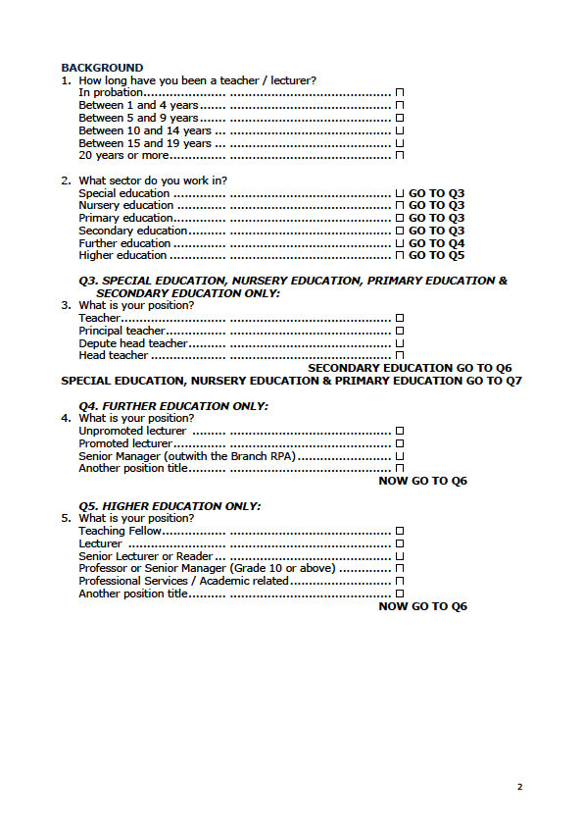
Word version of questionnaire (p1-2)
66

Slide 67
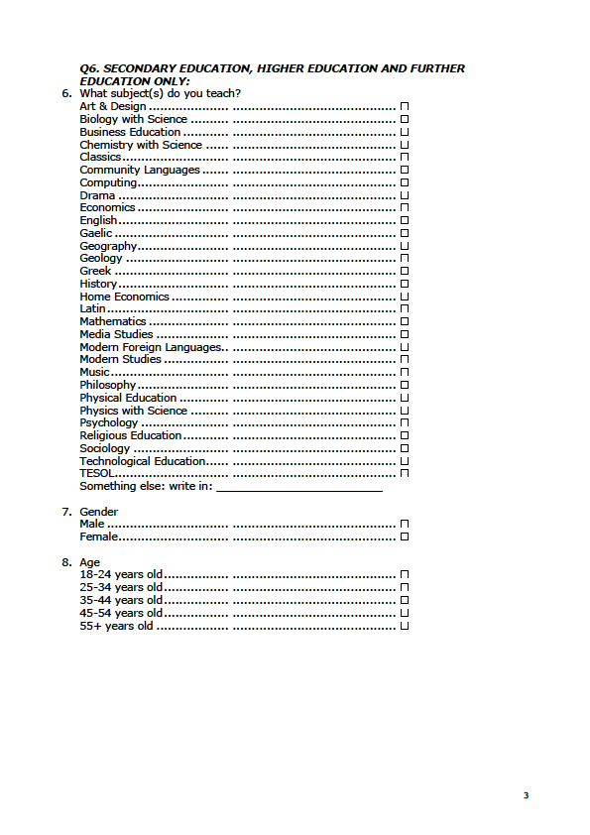
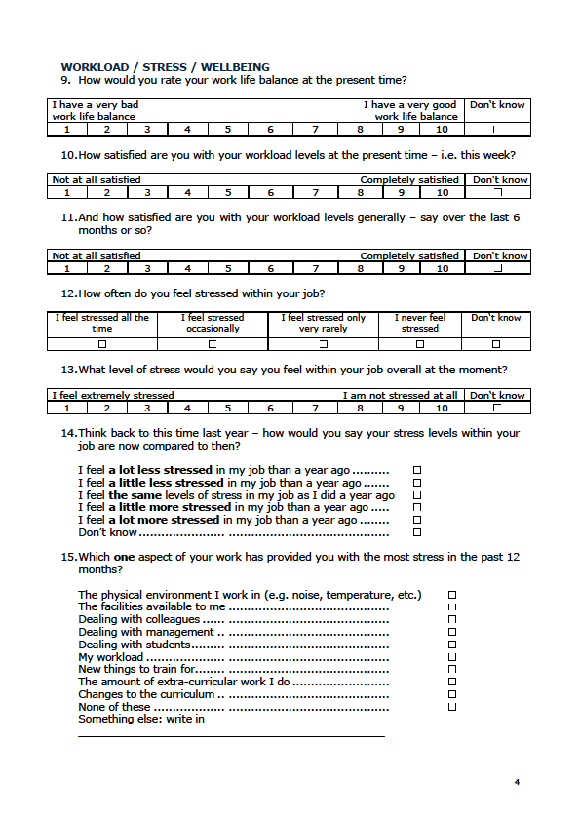
Word version of questionnaire (p3-4)
67

Slide 68
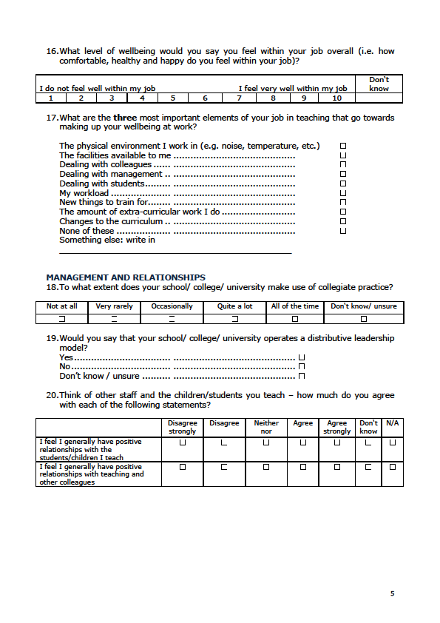
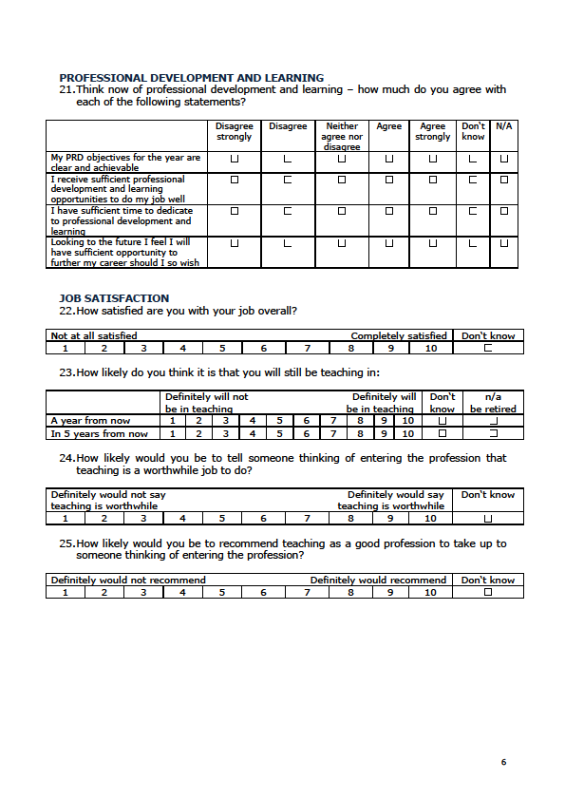
Word version of questionnaire (p5-6)
68

Slide 69
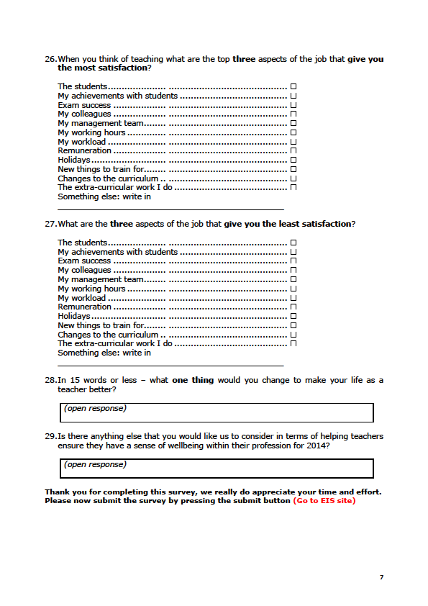
Word version of questionnaire (p7)
69

